Slide 1
Engineering Principles for Elimination of Industrial and Hazardous Waste
Name
Institution

Slide 2
Introduction
The disposal of industrial wastes containing heavy metals has recently attracted much attention given they can be absorbed by aquatic life and eventually enter the human food chain.
These result in health risks for humanity.
Various technologies have been used over time to manage and eliminate industrial and hazardous wastes.
Adsorption techniques are the most common processes used to eliminate solid wastes from water.

Slide 3
Treatment technologies for Removal of waste from water
Chemical precipitation
Membrane separation
Ultrafiltration
Adsorption
Ion exchange
Electrochemical degradation
This paper will discuss adsorption technique.
(LaGrega, Buckingham & Evans, 2001)

Slide 4
Adsorption
This technique involves attracting a dissolved materials and holding them on the pore spaces of the adsorber material.
Carbon is the commonly used absorption material.
Other materials can be used as well.
For households, carbon adsorption is used to eliminate chlorine from water.
(Anagoria, 2013)

Slide 5
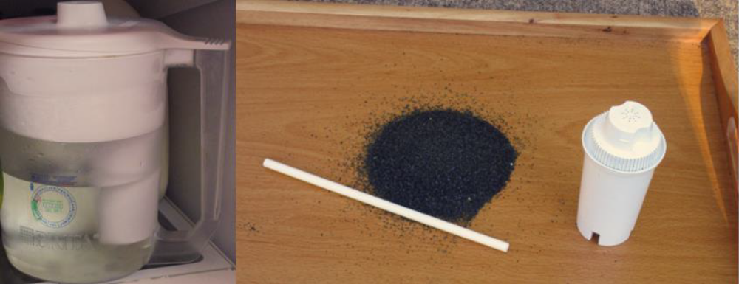
Home Water Filtration System

Slide 6
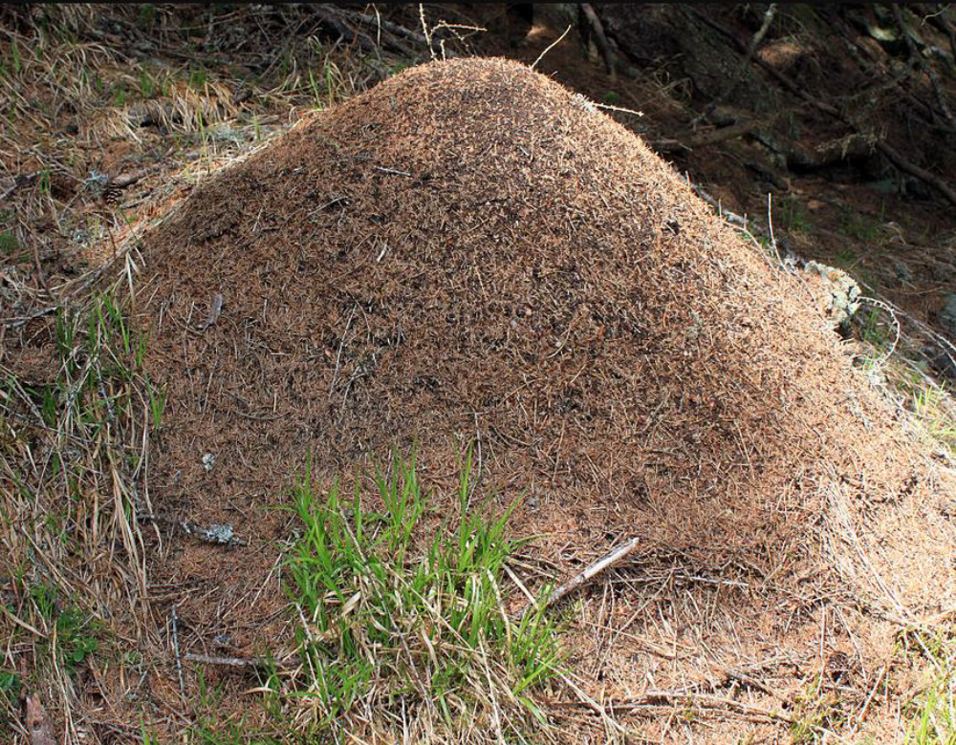
Anthill for collecting materials for heating

Slide 7
Commonly used Adsorbents
Silicic Acid
Natural clay minerals
Natural/synthetic zeolites
Activated aluminium and silica gel

Slide 8
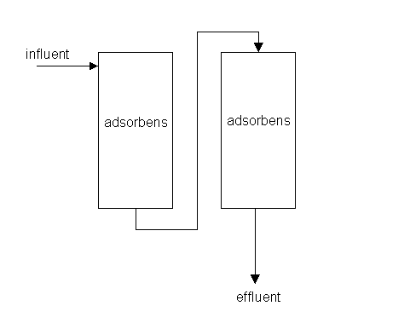
The process

Slide 9
Cont:-
The water containing the solid waste to be eliminated is passed through adsorbents.
The adsorbents absorb all the solid wastes and purifies the water.
The purified water gets out and is collected as effluent.

Slide 10
Characteristics of Adsorbent Materials
SEM images are prepared before and after adsorption. They show different properties altogether.
A thermally heated anthill has different pores on its surface as shown in (a) and (b) in the next slide.
(Anagoria, 2013)

Slide 11
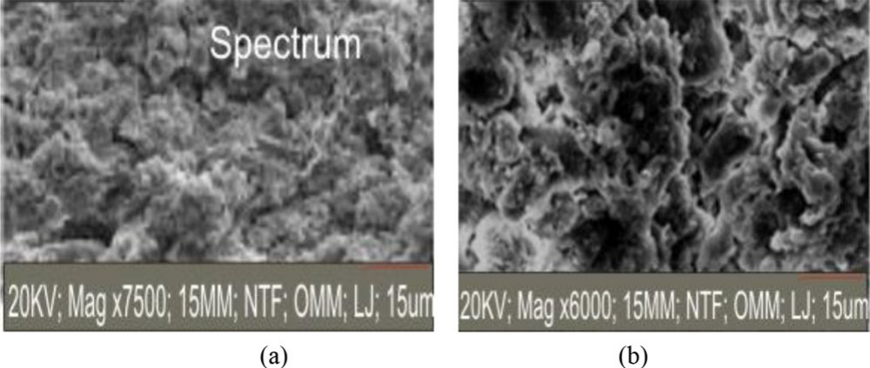
Cont:-

Slide 12
Cont:-
The chemical composition varies in the anthill.
  A high percentage consists silica
  Other components include:
    Alumina and
    Zircona

Slide 13
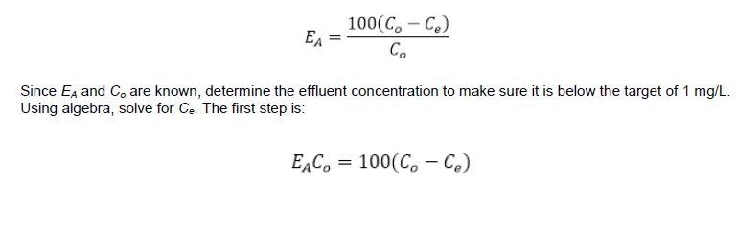
Engineering Calculations
Yusuff & Olateju, 2018

Slide 14
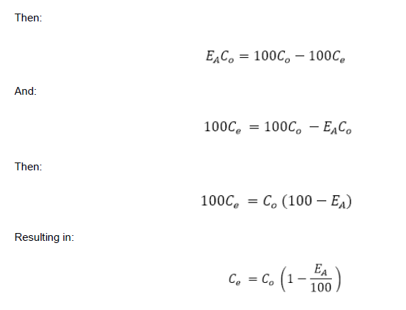
Calculations
Yusuff & Olateju, 2018

Slide 15
Advantages of Adsorption
Reduces the use of chemicals thus limiting environmental pollution.
It also removes intermediate processes.
The reduced chemical consumption is economical and reduces financial constraints.

Slide 16
Conclusion
Solid industrial wastes can be detrimental.
However, various technologies are available to eliminate solid waste from water.
Engineering technologies have been influential over time.
Adsorption is easy, cost effective and environmentally friendly.

Slide 17
References
Anagoria. (2013). Anthill in South Tyrol [Photograph]. Retrieved from https://commons.wikimedia.org/wiki/File:2013-05-09_Ameisenhaufen_in_S%C3%BCdtirol_Formicidae_anagoria.JPG
LaGrega, M. D., Buckingham, P. L., & Evans, J. C. (2001). Hazardous waste management (2nd ed.). Long Grove, IL: Waveland Press.
Yusuff, A. S., & Olateju, I. I. (2018). Experimental investigation of adsorption capacity of anthill in the removal of heavy metals from aqueous solution. Environmental Quality Management, 27(3), 53–59. Retrieved from https://libraryresources.columbiasouthern.edu/login?url=http://search.ebscohost.com/login.aspx?direct=true&db=bsu&AN=130104586&site=ehost-live&scope=site

Slide 18


